Slide 1

Project Title: WORD-LEVEL LAGUAGE IDENTIFICATION IN CODE-MIXED DRAVIDIAN LANGUAGES
Under the Guidance of:
Dr. H. L. Shashirekha
Presented By:
Name: SONITH D
Reg.No: P05AZ22SO38060

Slide 2
Table of Contents
Introduction
Problem statement
Literature survey
Contribution to Dataset Creation
Methodology
Experiments and results
Conclusion
References

Slide 3
Introduction
India's multilingual heritage leads to frequent use of multiple languages on social media platforms like Twitter and Instagram.
Code-mixing, where users switch between languages and combine words, challenges accurate language identification.
Language Identification (LI) in NLP is the process of determining the language of a given text.
Word-Level Language Identification (WLLI) is crucial for understanding multilingual content on digital platforms.

Slide 4
Problem Statement
The work addresses Word-Level Language Identification (WLLI) challenges in code-mixed Dravidian languages like Malayalam, Kannada, Tamil, and Tulu.
Existing computational tools and models are primarily designed for monolingual texts, limiting their effectiveness with code-mixed data.
The project aims to develop robust models to handle frequent language switching, borrowed terms, and informal usage in code-mixed texts.
The goal is to enhance NLP tasks, such as language detection, in multilingual code-mixed environments.

Slide 5
Objectives
Dataset Creation and Annotation: Creating code-mixed Malayalam WLLI dataset with sequences of words and performing manual annotation. Where by, tagging words with one of eight labels: MALAYALAM, ENGLISH, SYMBOL (SYM), OTHER, NAME, MIXED, NUMBER, and PLACE to facilitate supervised learning.
Implementing baseline models: various baseline models for the code-mixed Malayalam dataset which can also support other code-mixed WLLI datasets.
Evaluating: these baseline models for code-mixed Kannada, Tamil, and Tulu datasets.

Slide 6
Literature Survey 1
Word level language identification in english telugu code mixed data: proposed by Gundapu et al.
A code-mixed Telugu-English dataset with 29,503 tokens is created by the authors for WLLI
Naïve Bayes (NB) and RF classifiers, with TF-IDF of characters sequences, and Hidden Markov Model (HMM) and CRF models with text-based features
Among these models, CRF model obtained a macro F1-score of 0.91
Literature Survey 2
Word Level Language Identification of Code Mixing Text in Social Media: Proposed by Kasthuri Shanmugalingam et.al
Their study uses Tamil-English code-mixed data from popular social media posts and comments
ML classifier trained based on features such as Tamil Unicode characters in Roman scripts, dictionaries, double consonant, and term frequency
Different ML classifiers such as NB, Logistic Regression(LR), Support Vector Machines (SVM), Decision Trees (DT) and Random Forest (RF)
Among that the highest accuracy of 89.46% was obtained for SVM classifier

Slide 7
Literature Survey 3
Language identification at word level in Sinhala-English code-mixed social media text: Proposed by Kasthuri Shanmugalingam & Sagara Sumathipala
Implemented ML classifier based on features such as Sinhala Unicode characters written in Roman scripts, dictionaries (BNL & LEXNORM), and term frequency
Different machine learning classifiers such as SVM, NB, LR, RF and DT were used in the evaluation process
Among them, the highest accuracy of 90.5% was obtained for RF classifier
Literature Survey 4
Language identification in code-mixed data using multichannel neural networks and context capture: proposed by Mandal et. al
Authors proposed an approach for word-level LI in code-mixed Bangla and Hindi texts
Their proposed methodology has two phases: i) implementing Multichannel Neural Networks (MNN) by combining Convolutional Neural Networks (CNN) and Long ShortTerm Memory (LSTM) and ii) feeding the output of MNN to Bidirectional LSTM+CRF model
With this approach, they obtained macro F1-scores of 93.49 and 93.32 for code-mixed Bangla and Hindi texts respectively

Slide 8
CONTRIBUTION - Dataset Creation
The code-mixed Malayalam comments are collected from “Dravidian-CodeMix - FIRE 2020 - Sentiment Analysis for Dravidian Languages in Code-Mixed Text” shared task.
Url: https://drive.google.com/file/d/1nOQGldbN-FlBzYuffbLvoxYuR9UQHFRe/view - train set https://drive.google.com/file/d/1QgTDkB-HJrcK0gOVi0pUGMIrsaV_8Wdz/view - dev set
These are YouTube comments related to the movie trailer.
These social media data consists of noise such as punctuation's, URLs, emojis, and special symbols are removed during the creation of dataset process.
The Malayalam code-mixed dataset contains code-mixing of two languages (Malayalam, and English).
The cleaned dataset were then split into sequence of words.
The dataset is first converted into Roman script and numbers are converted into their word form, for the purpose of WLLI and manually annotated with eight labels (MALAYALAM, ENGLISH, SYMBOL (SYM), OTHER, NAME, MIXED, NUMBER, and PLACE).
The created dataset consists of 47,255 words and labels respectively.
The dataset is split into train and test set for evaluating model performance which consists of 37,818 samples for train set and 9,437 samples for test set respectively.

Slide 9
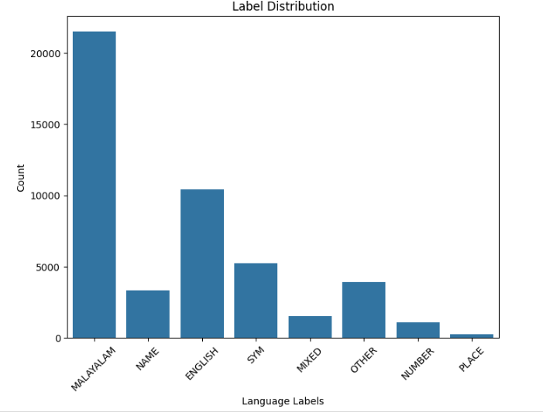
Code-mixed Malayalam dataset statistics

Slide 10
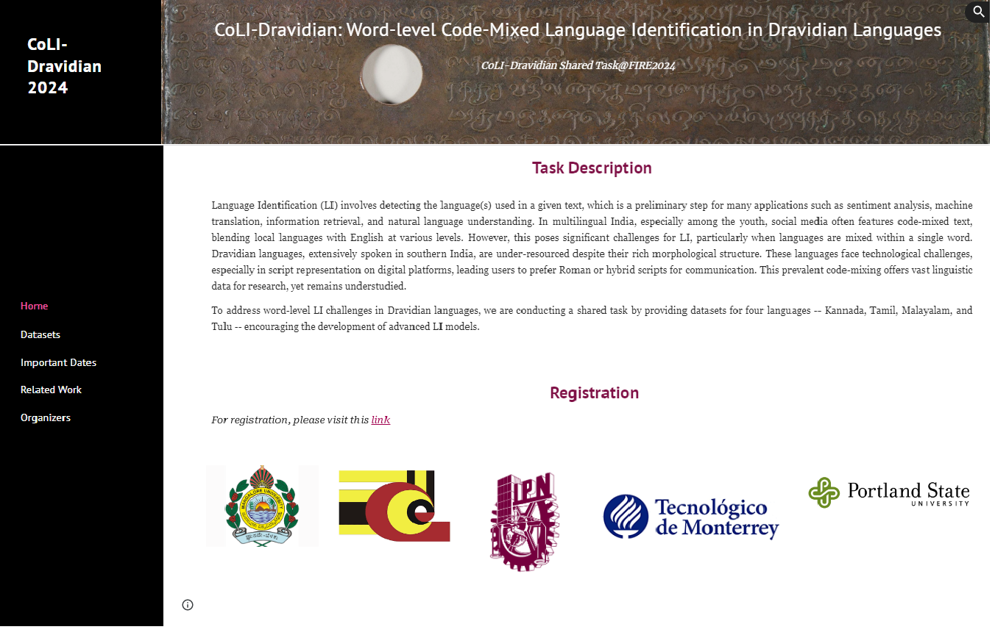
Dataset Release and Participation in CoLiDravidian 2024 SharedTask
Task description on WLLI in code-Mixed Dravidian Languages

Slide 11
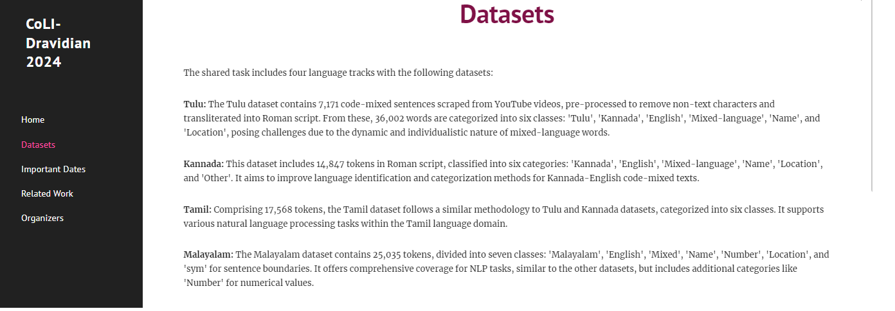
Dataset Release and Participation in CoLiDravidian 2024 SharedTask (Cont.)
Release of few code-Mixed Malayalam dataset

Slide 12
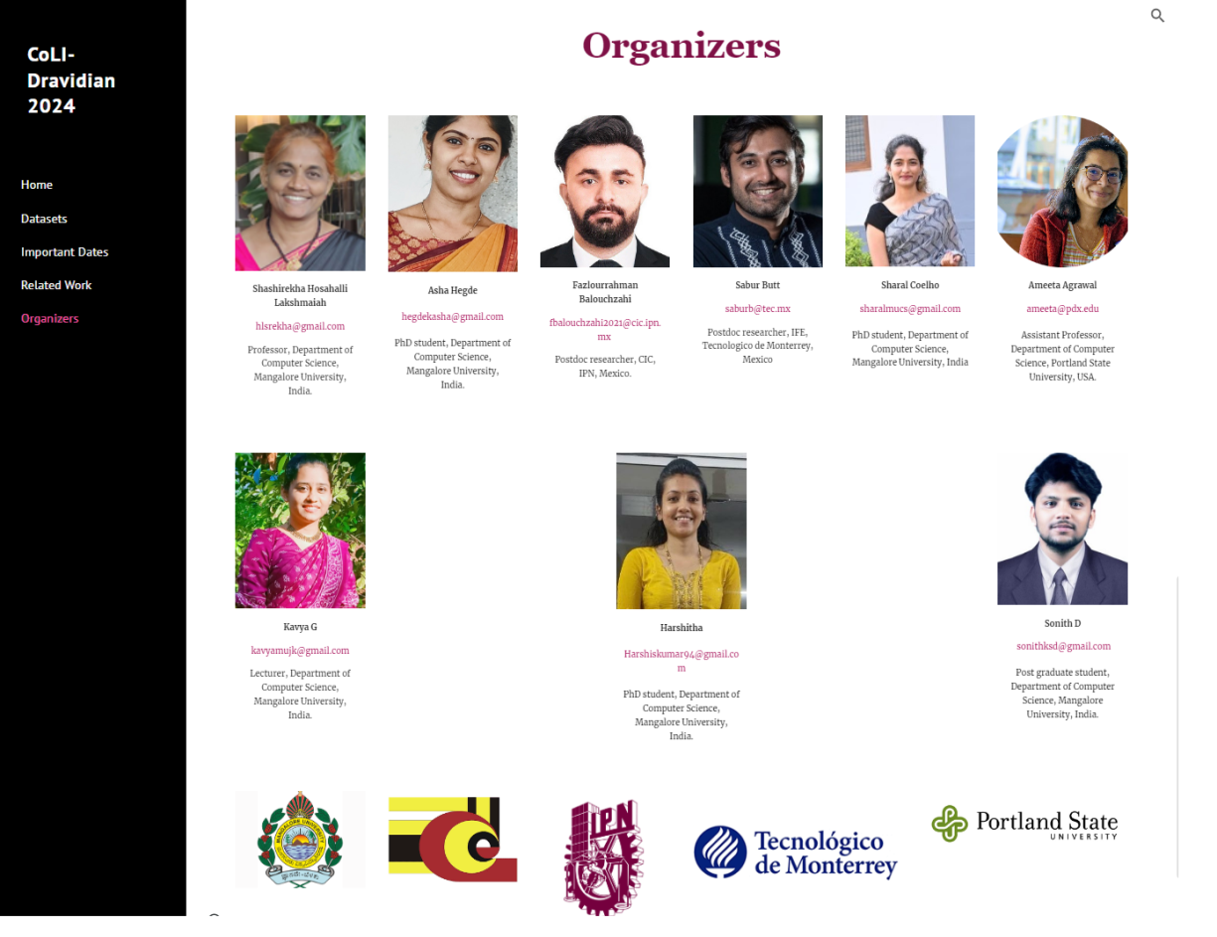
Dataset Release and Participation in CoLiDravidian 2024 SharedTask (Cont.)
Collaboration in CoLI-Dravidian Shared Task@FIRE2024

Slide 13
METHODOLOGY
Feature extraction is a process of transforming a raw text into a more structured format that can be used for further processing by any classifiers.
Two types of feature extraction methods are used
1. Handcrafted Features : For these features used Term Frequency Inverse Document Frequency (TF-IDF) vectors. Feature is vectorized using TF-IDF vectorizer Character n-grams: (1, 4)
2. Pre - trained Embeddings: Pre-trained word embeddings are pre-computed vector representations of words in a natural language that have been trained on a large amount of text data
fastText:
Steps carried out to obtain pre-trained fastText embeddings are:
English and Malayalam fastText word vector
Combining vector values of both English and Malayalam into a single pickle file
Searching for English word in English fastText and Malayalam in Malayalam fastText embeddings
Out-of-Vocabulary – Assigning random values for Individual characters in the word except English and Malayalam labels
3. BERT embeddings: are contextualized word representations derived from a pre-trained language model.
BERT embeddings capture the context of a wordwithin a sentence, leading to more accurate representation. In this study, multilingual BERT embeddings are used.

Slide 14
Machine Learning Classifier
Models | Hyperparameter | Values
SVM | Kernel | Linear / rbf
 | C | 1.0
LSVC | kernel | Linear
MNB | alpha | 1.0
LR | solver | liblinear
DT | random state | 0
kNN | n neighbors | 3
MLP | max iter | 500
 | random state | 42
RF | random state | 42
CatBoost | iterations | 1000
 | learning rate | 0.1
 | loss function | MultiClass
XGBoost | objective | multi:softmax
AdaBoost | n estimators | 50

Slide 15
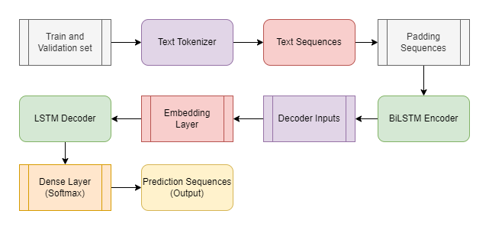
CRF Model
Features
A word | Previous word-2
Length of word | Previous word-3
Is the word at the beginning of the sentence | Previous word-4
Is the word at the end of the sentence | Next word+2
Is current word digit | Next word+3
Is current word punctuation | Next word+4
Sequence to Sequence Model

Slide 16
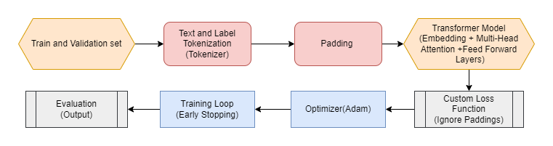
BiLSTM
Hyperparameter | Value
max_words | 15,000
max_len | 100
embedding_dim | 100
lstm_units | 128
dropout_rate | 0.3
batch_size | 8
epochs | 50
patience | 2
Transformer Neural Network – Customized LI

Slide 17
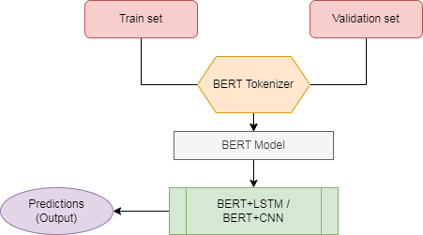
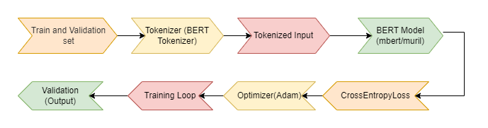
Hybrid Model (mBERT+CNN/LSTM , Muril+CNN/LSTM)
Transformer model using Pretrained BERT variants (mBERT, MuRiL)

Slide 18
Experiments and Results
Dataset Description
Label | Total No. Of Samples
MALAYALAM | 21,508
ENGLISH | 10,398
SYM | 5,255
OTHER | 3,898
NAME | 3,349
MIXED | 1,525
NUMBER | 1,073
PLACE | 242
Table: Statistics of the Malayalam code-mixed Dataset

Slide 19
LANGUAGES
KANNADA |  | TAMIL |  | TULU
Label | Total No. of samples | Label | Total No. of samples | Label | Total No. of samples
en | 18,777 | tm | 8,064 | Tulu | 12,900
sym | 4,064 | en | 3,259 | English | 8,222
kn | 4,260 | tmen | 1,399 | sym | 4,665
other | 2,626 | sym | 1,394 | Kannada | 3,223
name | 1,381 | name | 1,309 | Name | 1,636
mixed | 1,257 | Other | 77 | Other | 723
location | 134 | Location | 11 | Mixed | 600
- | - | - | - | Location | 560
Total | 32,499 | Total | 15,513 | Total | 32,529
Table: Statistics of the code-mixed Kannada, Tamil, and Tulu Dataset

Slide 20
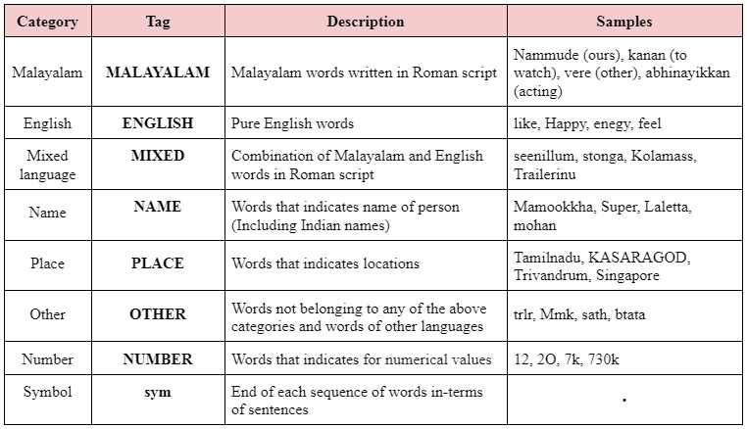
Code-mixed Malayalam dataset Samples

Slide 21
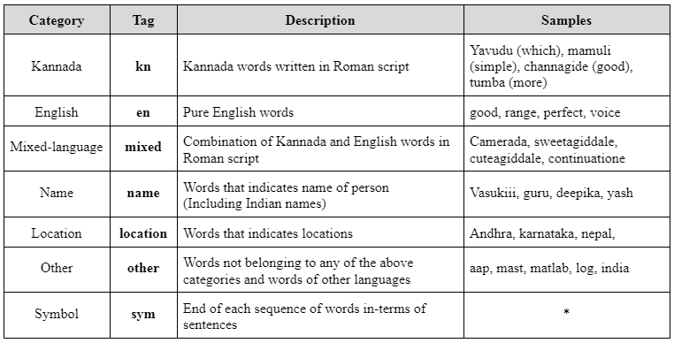
Code-mixed Kannada dataset Samples

Slide 22
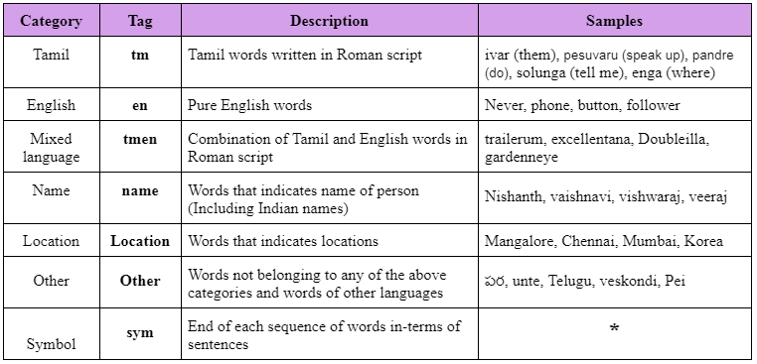
Code-mixed Tamil dataset Samples

Slide 23
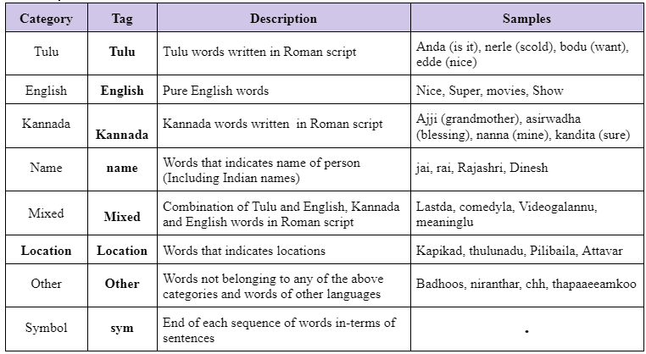
Code-mixed Tulu dataset Samples

Slide 24
Performance of the proposed ML models trained with char TF-IDF on code-mixed Malayalam dataset
Model | Precision | Recall | Macro F1 score | Weighted F1 score | Accuracy
SVM | 0.85 | 0.75 | 0.78 | 0.88 | 0.89
LR | 0.83 | 0.69 | 0.72 | 0.86 | 0.87
MNB | 0.71 | 0.59 | 0.60 | 0.82 | 0.84
DT | 0.79 | 0.76 | 0.76 | 0.87 | 0.87
KNN | 0.80 | 0.74 | 0.75 | 0.87 | 0.87
RF | 0.84 | 0.75 | 0.78 | 0.88 | 0.89
LSVC | 0.83 | 0.77 | 0.78 | 0.89 | 0.89
MLP | 0.82 | 0.78 | 0.78 | 0.88 | 0.88
CatBoost | 0.83 | 0.70 | 0.73 | 0.86 | 0.87
XGBoost | 0.83 | 0.75 | 0.78 | 0.88 | 0.88
AdaBoost | 0.36 | 0.19 | 0.18 | 0.41 | 0.49
Ensemble (XGB, SVM, RF) | 0.89 | 0.80 | 0.83 | 0.94 | 0.94

Slide 25
Performance of the ML models trained with fastText word vectors on code-mixed Malayalam dataset
Model | Precision | Recall | Macro F1 score | Weighted F1 score | Accuracy
SVM | 0.16 | 0.22 | 0.18 | 0.47 | 0.59
LR | 0.24 | 0.21 | 0.19 | 0.47 | 0.57
DT | 0.34 | 0.33 | 0.34 | 0.60 | 0.60
KNN | 0.13 | 0.20 | 0.15 | 0.39 | 0.40
RF | 0.35 | 0.37 | 0.34 | 0.67 | 0.76
LSVC | 0.22 | 0.23 | 0.21 | 0.46 | 0.49
CatBoost | 0.37 | 0.37 | 0.34 | 0.67 | 0.76
XGBoost | 0.42 | 0.37 | 0.35 | 0.68 | 0.76
AdaBoost | 0.30 | 0.32 | 0.30 | 0.58 | 0.65
Ensemble (MNB, RF, DT) | 0.36 | 0.37 | 0.35 | 0.66 | 0.73

Slide 26
Performance of the ML models trained with mBERT embedding on code-mixed Malayalam dataset
Model | Precision | Recall | Macro F1 score | Weighted F1 score | Accuracy
SVM | 0.70 | 0.69 | 0.69 | 0.83 | 0.82
LR | 0.79 | 0.71 | 0.73 | 0.86 | 0.86
RF | 0.32 | 0.30 | 0.29 | 0.59 | 0.67
MLP | 0.79 | 0.75 | 0.76 | 0.87 | 0.87
DT | 0.70 | 0.69 | 0.69 | 0.83 | 0.82
CB | 0.84 | 0.72 | 0.75 | 0.87 | 0.87
XGB | 0.84 | 0.72 | 0.75 | 0.87 | 0.87
AdaBoost | 0.21 | 0.24 | 0.22 | 0.46 | 0.55
Ensemble (XGB, CB, MLP) | 0.83 | 0.73 | 0.76 | 0.87 | 0.88

Slide 27
Performance of the ML models trained with char TF-IDF on code-mixed Kannada dataset
Model | Precision | Recall | Macro F1 score | Weighted F1 score | Accuracy
SVM | 0.89 | 0.81 | 0.83 | 0.94 | 0.94
LR | 0.87 | 0.75 | 0.79 | 0.90 | 0.90
MNB | 0.71 | 0.63 | 0.66 | 0.87 | 0.88
DT | 0.82 | 0.80 | 0.80 | 0.92 | 0.92
KNN | 0.85 | 0.77 | 0.80 | 0.92 | 0.92
RF | 0.88 | 0.80 | 0.83 | 0.93 | 0.93
LSVC | 0.87 | 0.82 | 0.84 | 0.95 | 0.95
MLP | 0.86 | 0.83 | 0.83 | 0.95 | 0.94
CatBoost | 0.87 | 0.76 | 0.79 | 0.90 | 0.91
XGBoost | 0.88 | 0.80 | 0.82 | 0.93 | 0.93
AdaBoost | 0.06 | 0.14 | 0.09 | 0.28 | 0.45
Ensemble (XGB, SVM, LSVC) | 0.88 | 0.81 | 0.83 | 0.94 | 0.94

Slide 28
Performance of the ML models trained with fastText word vectors on code-mixed Kannada dataset
Model | Precision | Recall | Macro F1 score | Weighted F1 score | Accuracy
SVM | 0.28 | 0.32 | 0.30 | 0.62 | 0.68
LR | 0.25 | 0.27 | 0.25 | 0.57 | 0.62
DT | 0.43 | 0.43 | 0.42 | 0.74 | 0.72
KNN | 0.19 | 0.21 | 0.19 | 0.47 | 0.57
RF | 0.48 | 0.48 | 0.41 | 0.76 | 0.75
LSVC | 0.28 | 0.32 | 0.30 | 0.62 | 0.68
CatBoost | 0.45 | 0.49 | 0.42 | 0.76 | 0.76
XGBoost | 0.50 | 0.52 | 0.46 | 0.79 | 0.77
AdaBoost | 0.37 | 0.37 | 0.34 | 0.68 | 0.70
Ensemble (MNB, RF, DT) | 0.50 | 0.49 | 0.43 | 0.76 | 0.76

Slide 29
Performance of the ML models trained mBERT embedding on code-mixed Kannada dataset
Model | Precision | Recall | Macro F1 score | Weighted F1 score | Accuracy
SVM | 0.76 | 0.76 | 0.75 | 0.89 | 0.89
LR | 0.81 | 0.79 | 0.79 | 0.92 | 0.92
RF | 0.22 | 0.29 | 0.24 | 0.44 | 0.58
MLP | 0.86 | 0.84 | 0.84 | 0.95 | 0.95
DT | 0.76 | 0.76 | 0.75 | 0.89 | 0.89
CB | 0.87 | 0.80 | 0.82 | 0.93 | 0.93
XGB | 0.89 | 0.82 | 0.83 | 0.94 | 0.94
AdaBoost | 0.06 | 0.14 | 0.09 | 0.45 | 0.28
Ensemble (XGB, CB, MLP) | 0.85 | 0.82 | 0.83 | 0.94 | 0.94

Slide 30
Performance of the ML models trained char TF-IDF on code-mixed Tamil dataset
Model | Precision | Recall | Macro F1 score | Weighted F1 score | Accuracy
SVM | 0.82 | 0.87 | 0.81 | 0.91 | 0.91
LR | 0.76 | 0.64 | 0.68 | 0.87 | 0.88
MNB | 0.73 | 0.55 | 0.58 | 0.80 | 0.82
DT | 0.61 | 0.72 | 0.62 | 0.87 | 0.87
KNN | 0.60 | 0.68 | 0.59 | 0.85 | 0.86
RF | 0.68 | 0.73 | 0.66 | 0.90 | 0.90
LSVC | 0.67 | 0.75 | 0.67 | 0.91 | 0.91
CatBoost | 0.76 | 0.67 | 0.70 | 0.88 | 0.89
XGBoost | 0.67 | 0.74 | 0.66 | 0.90 | 0.90
AdaBoost | 0.36 | 0.33 | 0.29 | 0.46 | 0.60
MLP | 0.64 | 0.74 | 0.64 | 0.89 | 0.89
Ensemble (SVM, LSVC, XGB) | 0.89 | 0.80 | 0.83 | 0.94 | 0.94

Slide 31
Performance of the ML models trained with fastText word vectors on code-mixed Tamil dataset
Model | Precision | Recall | Macro F1 score | Weighted F1 score | Accuracy
SVM | 0.42 | 0.32 | 0.31 | 0.62 | 0.69
LR | 0.33 | 0.30 | 0.29 | 0.59 | 0.65
DT | 0.47 | 0.45 | 0.46 | 0.71 | 0.71
KNN | 0.20 | 0.26 | 0.21 | 0.49 | 0.55
RF | 0.63 | 0.50 | 0.48 | 0.77 | 0.84
LSVC | 0.42 | 0.32 | 0.31 | 0.62 | 0.69
CatBoost | 0.53 | 0.50 | 0.49 | 0.78 | 0.83
XGBoost | 0.54 | 0.50 | 0.49 | 0.78 | 0.83
AdaBoost | 0.45 | 0.42 | 0.41 | 0.71 | 0.76
Ensemble (MNB, RF, DT) | 0.53 | 0.50 | 0.48 | 0.78 | 0.84

Slide 32
Performance of the ML models trained with BERT embedding on code-mixed Kannada dataset
Model | Precision | Recall | Macro F1 score | Weighted F1 score | Accuracy
SVM | 0.64 | 0.63 | 0.63 | 0.83 | 0.83
LR | 0.88 | 0.75 | 0.75 | 0.91 | 0.91
RF | 0.43 | 0.39 | 0.38 | 0.61 | 0.68
MLP | 0.75 | 0.90 | 0.77 | 0.91 | 0.91
DT | 0.64 | 0.63 | 0.63 | 0.83 | 0.83
CB | 0.75 | 0.71 | 0.73 | 0.91 | 0.91
XGB | 0.80 | 0.87 | 0.79 | 0.91 | 0.91
AdaBoost | 0.33 | 0.32 | 0.31 | 0.59 | 0.64
Ensemble (XGB, CB, MLP) | 0.80 | 0.89 | 0.79 | 0.92 | 0.92

Slide 33
Performance of the ML models trained char TF-IDF on code-mixed Tulu dataset
Model | Precision | Recall | Macro F1 score | Weighted F1 score | Accuracy
SVM | 0.89 | 0.75 | 0.80 | 0.88 | 0.89
LR | 0.88 | 0.66 | 0.70 | 0.85 | 0.86
MNB | 0.76 | 0.52 | 0.55 | 0.80 | 0.83
DT | 0.77 | 0.77 | 0.77 | 0.87 | 0.87
KNN | 0.82 | 0.75 | 0.78 | 0.87 | 0.87
RF | 0.89 | 0.77 | 0.81 | 0.89 | 0.89
LSVC | 0.86 | 0.79 | 0.82 | 0.89 | 0.90
MLP | 0.83 | 0.79 | 0.81 | 0.89 | 0.89
CatBoost | 0.86 | 0.68 | 0.74 | 0.85 | 0.86
XGBoost | 0.86 | 0.76 | 0.80 | 0.88 | 0.88
AdaBoost | 0.43 | 0.35 | 0.36 | 0.58 | 0.61
Ensemble (LSVC, RF, MLP) | 0.86 | 0.79 | 0.82 | 0.90 | 0.90

Slide 34
Performance of the ML models trained with fastText word vectors on code-mixed Tulu dataset
Model | Precision | Recall | Macro F1 score | Weighted F1 score | Accuracy
SVM | 0.18 | 0.15 | 0.12 | 0.35 | 0.48
LR | 0.20 | 0.17 | 0.16 | 0.39 | 0.49
DT | 0.27 | 0.26 | 0.27 | 0.48 | 0.47
KNN | 0.15 | 0.15 | 0.12 | 0.35 | 0.48
RF | 0.27 | 0.29 | 0.27 | 0.55 | 0.63
LSVC | 0.18 | 0.15 | 0.12 | 0.35 | 0.48
CatBoost | 0.26 | 0.29 | 0.27 | 0.55 | 0.63
XGBoost | 0.28 | 0.29 | 0.27 | 0.54 | 0.61
AdaBoost | 0.26 | 0.27 | 0.26 | 0.52 | 0.60
Ensemble (XGB, RF, DT) | 0.28 | 0.29 | 0.27 | 0.55 | 0.62

Slide 35
Performance of the ML models trained with BERT embedding on code-mixed Kannada dataset
Model | Precision | Recall | Macro F1 score | Weighted F1 score | Accuracy
SVM | 0.69 | 0.71 | 0.70 | 0.82 | 0.82
LR | 0.77 | 0.73 | 0.74 | 0.85 | 0.85
RF | 0.32 | 0.33 | 0.31 | 0.63 | 0.71
MLP | 0.79 | 0.78 | 0.78 | 0.87 | 0.87
DT | 0.69 | 0.71 | 0.70 | 0.82 | 0.82
CB | 0.88 | 0.72 | 0.78 | 0.86 | 0.87
XGB | 0.88 | 0.73 | 0.79 | 0.87 | 0.87
AdaBoost | 0.45 | 0.37 | 0.38 | 0.64 | 0.68
Ensemble (XGB, CB, MLP) | 0.88 | 0.75 | 0.80 | 0.88 | 0.88

Slide 36
Language | Precision | Recall | Macro F1 score | Weighted F1 score | Accuracy
Malayalam | 0.6286 | 0.5390 | 0.5626 | 0.8626 | 0.8648
Kannada | 0.9046 | 0.8237 | 0.8565 | 0.9498 | 0.9513
Tamil | 0.7260 | 0.7166 | 0.7210 | 0.8960 | 0.8967
Tulu | 0.8408 | 0.7299 | 0.7744 | 0.8645 | 0.8676
Table : Performance of the CRF model on code-mixed Dravidian languages
Language | Precision | Recall | Macro F1 score | Weighted F1 score | Accuracy
Malayalam | 0.32 | 0.29 | 0.30 | 0.67 | 0.67
Kannada | 0.65 | 0.49 | 0.52 | 0.83 | 0.82
Tamil | 0.25 | 0.26 | 0.25 | 0.52 | 0.55
Tulu | 0.55 | 0.51 | 0.53 | 0.78 | 0.77
Table : Performance of the Sequence to Sequence model on code-mixed Dravidian languages

Slide 37
Language | Precision | Recall | Macro F1 score | Weighted F1 score | Accuracy
Malayalam | 0.87 | 0.69 | 0.74 | 0.85 | 0.86
Kannada | 0.96 | 0.75 | 0.81 | 0.92 | 0.92
Tamil | 0.72 | 0.56 | 0.59 | 0.80 | 0.82
Tulu | 0.70 | 0.61 | 0.64 | 0.82 | 0.84
Table : Performance of the BiLSTM model on code-mixed Dravidian languages
Language | Precision | Recall | Macro F1 score | Weighted F1 score | Accuracy
Malayalam | 0.86 | 0.61 | 0.67 | 0.82 | 0.84
Kannada | 0.93 | 0.67 | 0.74 | 0.82 | 0.84
Tamil | 0.72 | 0.48 | 0.49 | 0.73 | 0.78
Tulu | 0.87 | 0.62 | 0.67 | 0.81 | 0.83
Table : Performance of the Transformer Neural Network – Custom LI model on code-mixed Dravidian languages

Slide 38
Language | Precision | Recall | Macro F1 score | Weighted F1 score | Accuracy
Malayalam | 0.81 | 0.75 | 0.76 | 0.88 | 0.88
Kannada | 0.88 | 0.83 | 0.84 | 0.95 | 0.95
Tamil | 0.66 | 0.63 | 0.64 | 0.92 | 0.93
Tulu | 0.81 | 0.69 | 0.72 | 0.85 | 0.87
Table : Performance of the model on code-mixed Dravidian languages
Language | Precision | Recall | Macro F1 score | Weighted F1 score | Accuracy
Malayalam | 0.72 | 0.72 | 0.71 | 0.89 | 0.89
Kannada | 0.71 | 0.76 | 0.73 | 0.94 | 0.94
Tamil | 0.64 | 0.64 | 0.64 | 0.92 | 0.92
Tulu | 0.63 | 0.61 | 0.61 | 0.84 | 0.86
Table : Performance of the TL MuRiL model on code-mixed Dravidian languages

Slide 39
Language | Precision | Recall | Macro F1 score | Weighted F1 score | Accuracy
Malayalam | 0.81 | 0.79 | 0.79 | 0.89 | 0.89
Kannada | 0.82 | 0.85 | 0.82 | 0.94 | 0.94
Tamil | 0.75 | 0.76 | 0.75 | 0.93 | 0.92
Tulu | 0.84 | 0.78 | 0.81 | 0.89 | 0.89
Table : Performance of the TL mBERT model on code-mixed Dravidian languages
Language | Precision | Recall | Macro F1 score | Weighted F1 score | Accuracy
Malayalam | 0.82 | 0.79 | 0.80 | 0.89 | 0.89
Kannada | 0.87 | 0.86 | 0.86 | 0.95 | 0.95
Tamil | 0.66 | 0.65 | 0.65 | 0.94 | 0.94
Tulu | 0.86 | 0.73 | 0.73 | 0.87 | 0.88
Table : Performance of the TL MuRiL model on code-mixed Dravidian languages

Slide 40
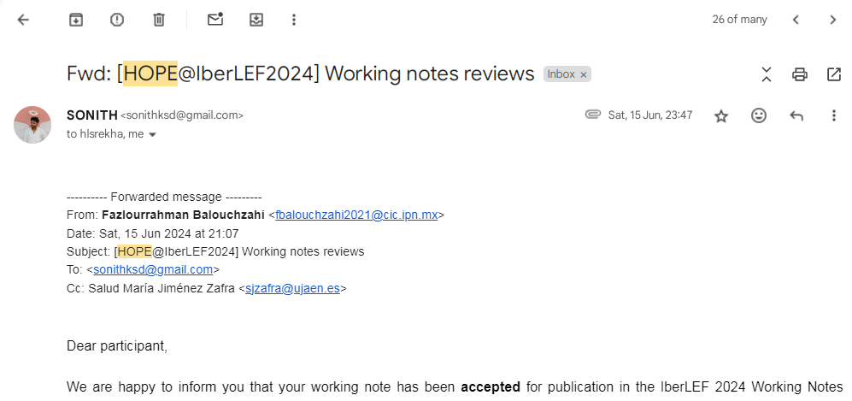
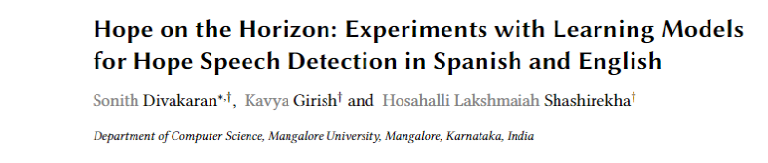
Publications:

Slide 41
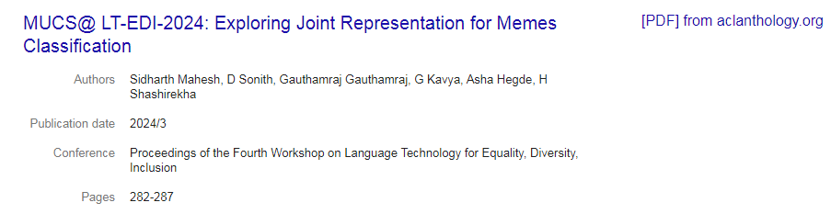
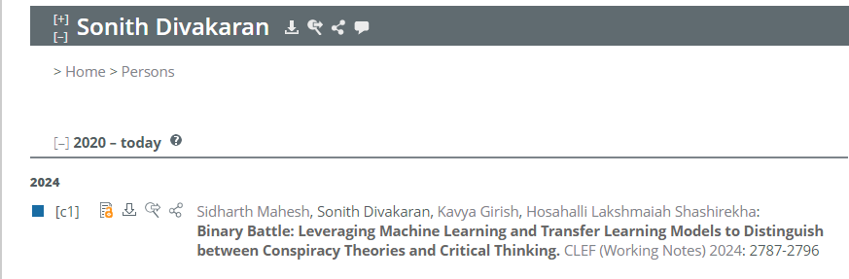
Publications (Cont.):

Slide 42
Publications (Cont.): In Progress: Participated in shared tasks: 1) CoLiDravidian –WLLI in Dravidian languages - secured 6th ranks in all languages 2) CryptoQA : Twitter and Reddit opinion comments on social media (English Dataset) – Hierarchical classification - Secured 5th rank 3) Sarcasm Detection - Binary classification – Tamil, Malayalam dataset - Secured 1st in Tamil, 2nd in Malayalam 4) HASOC – Zero shot learning and Multitask learning Working Note: All of the above task related working notes will be sent and these papers will be published in FIRE 2024 conference.

Slide 43
Conclusion

